Slide 1

Classification (Ensemble Methods) Part 2 : Boosting AdaBoost
by:
Eng. Alaa Al Nissany

Slide 2
Machine Learning
Supervised Learning
Unsupervised Learning
Reinforcement Learning
Classification
Clustering
Q-Learning
Regression
Anomaly Detection
DQN
Ranking
Dimensionality reduction

Slide 3
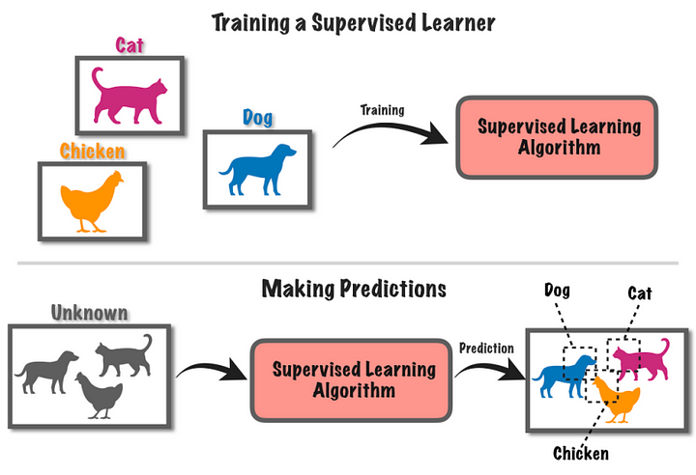
Supervised Learning

Slide 4
Ensemble Learning
Bagging
Boosting
Stacking

Slide 5

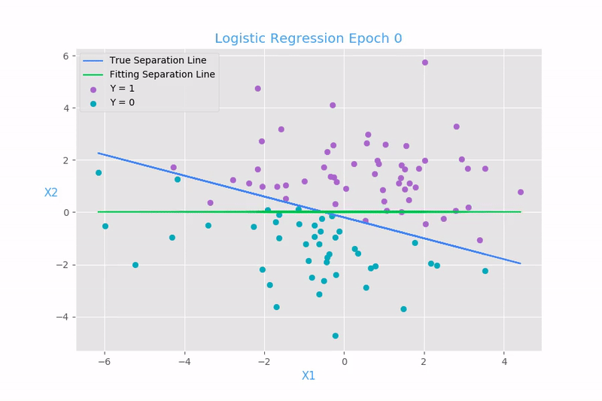

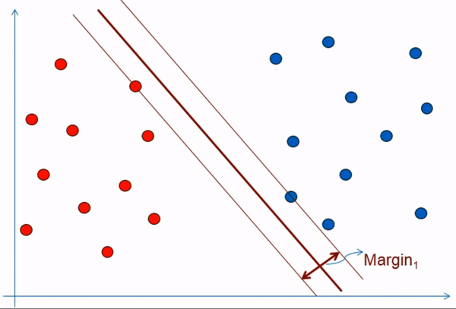

Bagging
Data Bootstrapping
Predictions
Final Prediction
Voting
Data
OR
Prediction Aggregation

Slide 6
Some Famous Bagging algorithms
Random Forest | EXTRA Trees
Optimized Bagging classifier on Decision Tree | Random Forest with splitting the subset of the data in every node by selecting a random thresholds for each feature in each node
Bagging algorithms trade more bias for lower variance

Slide 7
Ensemble Learning
Bagging
Boosting
Stacking

Slide 8
Boosting

Slide 9
AdaBoost

Slide 10
Stumps
Root Node
Leaf Node

Slide 11
Stumps Vs Full tree
Full Tree | Stump
Take advantages of many Feature to make a decision | Use Only one Feature in making its decision
Weak classifier Or Weak learner Or Base learner
Strong learner

Slide 12
AdaBoost
Animal | Color | Size | Cuteness
Dog | Brown | Small | Medium
Cat | Brown | Small | Medium
Dog | Brown | Small | High
Cat | Gold | Medium | High
Cat | Black | Medium | High
Dog | Gold | Small | Medium
Cat | Brown | Medium | Low
Dog | Gold | Large | High
Cat | Brown | Medium | Medium
Dog | Black | Large | High
Cat | Gold | Large | Medium
Cat | Brown | Small | High

Slide 13
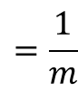
$$=\frac{1}{m}$$
AdaBoost
Initial Step (Step 0)
Animal | Color | Size | Cuteness |  | Record weight
Dog | Brown | Small | Medium |  | 1/12
Cat | Brown | Small | Medium |  | 1/12
Dog | Brown | Small | High |  | 1/12
Cat | Gold | Medium | High |  | 1/12
Cat | Black | Medium | High |  | 1/12
Dog | Gold | Small | Medium |  | 1/12
Cat | Brown | Medium | Low |  | 1/12
Dog | Gold | Large | High |  | 1/12
Cat | Brown | Medium | Medium |  | 1/12
Dog | Black | Large | High |  | 1/12
Cat | Gold | Large | Medium |  | 1/12
Cat | Brown | Small | High |  | 1/12
m=12

Slide 14
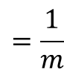
AdaBoost
$$=\frac{1}{m}$$
Initial Step (Step 0)
Animal | Color | Size | Cuteness |  | Record weight
Dog | Brown | Small | Medium |  | 1/12
Cat | Brown | Small | Medium |  | 1/12
Dog | Brown | Small | High |  | 1/12
Cat | Gold | Medium | High |  | 1/12
Cat | Black | Medium | High |  | 1/12
Dog | Gold | Small | Medium |  | 1/12
Cat | Brown | Medium | Low |  | 1/12
Dog | Gold | Large | High |  | 1/12
Cat | Brown | Medium | Medium |  | 1/12
Dog | Black | Large | High |  | 1/12
Cat | Gold | Large | Medium |  | 1/12
Cat | Brown | Small | High |  | 1/12
Initialize the samples weights
m=12

Slide 15
AdaBoost
Animal | Color | Size | Cuteness |  | Record weight
Dog | Brown | Small | Medium |  | 1/12
Cat | Brown | Small | Medium |  | 1/12
Dog | Brown | Small | High |  | 1/12
Cat | Gold | Medium | High |  | 1/12
Cat | Black | Medium | High |  | 1/12
Dog | Gold | Small | Medium |  | 1/12
Cat | Brown | Medium | Low |  | 1/12
Dog | Gold | Large | High |  | 1/12
Cat | Brown | Medium | Medium |  | 1/12
Dog | Black | Large | High |  | 1/12
Cat | Gold | Large | Medium |  | 1/12
Cat | Brown | Small | High |  | 1/12
Step 1
Compute the Gini Index for the Data after splitting it by every Feature

Slide 16
AdaBoost
Step 1
Compute the Gini Index for the Data after splitting it by every Feature
Color
Size
Cuteness
BR
BL
GO
S
M
L
L
M
H
4 | 1 | 2
2 | 1 | 2
2 | 4 | 1
3 | 0 | 2
1 | 3 | 3
0 | 2 | 3

Slide 17
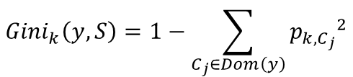
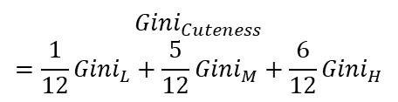
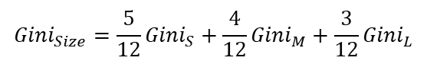
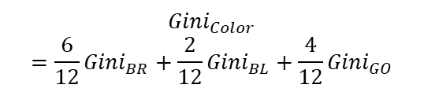
AdaBoost
Step 1
Compute the Gini Index for the Data after splitting it by every Feature
$${Gini}_{k}\left(y,S\right)=1−\sum_{C_{j}∈Dom\left(y\right)}{{p_{k,C_{j}}}^{2}}$$
Color
Cuteness
Size
BR
BL
GO
L
M
H
S
M
L
$${Gini}_{Color}=\frac{6}{12}{Gini}_{BR}+\frac{2}{12}{Gini}_{BL}+{\frac{4}{12}Gini}_{GO}$$
$${Gini}_{Cuteness}=\frac{1}{12}{Gini}_{L}+\frac{5}{12}{Gini}_{M}+{\frac{6}{12}Gini}_{H}$$
$${Gini}_{Size}=\frac{5}{12}{Gini}_{S}+\frac{4}{12}{Gini}_{M}+{\frac{3}{12}Gini}_{L}$$

Slide 18
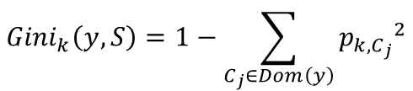


AdaBoost
Step 1
Compute the Gini Index for the Data after splitting it by every Feature
$${Gini}_{k}\left(y,S\right)=1−\sum_{C_{j}∈Dom\left(y\right)}{{p_{k,C_{j}}}^{2}}$$
Color
Cuteness
Size
BR
BL
GO
L
M
H
S
M
L
$${Gini}_{Color}=0.4722$$
$${Gini}_{Cuteness}=0.45$$
$${Gini}_{Size}=0.311$$

Slide 19
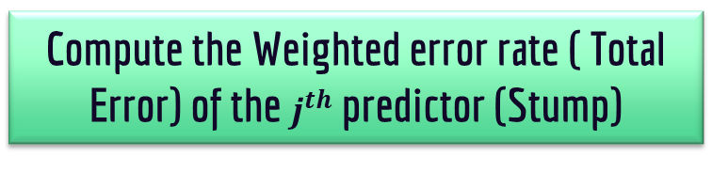
AdaBoost
Compute the Weighted error rate ( Total Error) of the $j^{th}$ predictor (Stump)
Step 2
Animal | Color | Size | Cuteness |  | Record weight
Dog | Brown | Small | Medium |  | 1/12
Cat | Brown | Small | Medium |  | 1/12
Dog | Brown | Small | High |  | 1/12
Cat | Gold | Medium | High |  | 1/12
Cat | Black | Medium | High |  | 1/12
Dog | Gold | Small | Medium |  | 1/12
Cat | Brown | Medium | Low |  | 1/12
Dog | Gold | Large | High |  | 1/12
Cat | Brown | Medium | Medium |  | 1/12
Dog | Black | Large | High |  | 1/12
Cat | Gold | Large | Medium |  | 1/12
Cat | Brown | Small | High |  | 1/12
Size
S
M
L
2 | 4 | 1
3 | 0 | 2

Slide 20
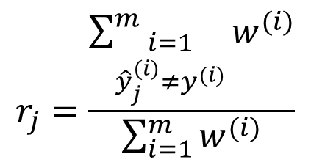
AdaBoost
Compute the Weighted error rate ( Total Error) of the $j^{th}$ predictor (Stump)
Step 2
Animal | Color | Size | Cuteness |  | Record weight
Dog | Brown | Small | Medium |  | 1/12
Cat | Brown | Small | Medium |  | 1/12
Dog | Brown | Small | High |  | 1/12
Cat | Gold | Medium | High |  | 1/12
Cat | Black | Medium | High |  | 1/12
Dog | Gold | Small | Medium |  | 1/12
Cat | Brown | Medium | Low |  | 1/12
Dog | Gold | Large | High |  | 1/12
Cat | Brown | Medium | Medium |  | 1/12
Dog | Black | Large | High |  | 1/12
Cat | Gold | Large | Medium |  | 1/12
Cat | Brown | Small | High |  | 1/12
Size
S
M
L
$$r_{j}=\frac{\sum_{\begin{aligned}i=1 \\ {\hat{y}}_{j}^{(i)}≠y^{(i)}\end{aligned}}^{m}{w^{(i)}}}{\sum_{i=1}^{m}{w^{(i)}}}$$

Slide 21
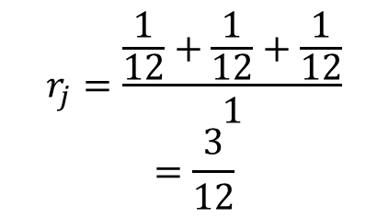
AdaBoost
Compute the Weighted error rate ( Total Error) of the $j^{th}$ predictor (Stump)
Step 2
Animal | Color | Size | Cuteness |  | Record weight
Dog | Brown | Small | Medium |  | 1/12
Cat | Brown | Small | Medium |  | 1/12
Dog | Brown | Small | High |  | 1/12
Cat | Gold | Medium | High |  | 1/12
Cat | Black | Medium | High |  | 1/12
Dog | Gold | Small | Medium |  | 1/12
Cat | Brown | Medium | Low |  | 1/12
Dog | Gold | Large | High |  | 1/12
Cat | Brown | Medium | Medium |  | 1/12
Dog | Black | Large | High |  | 1/12
Cat | Gold | Large | Medium |  | 1/12
Cat | Brown | Small | High |  | 1/12
Size
S
M
L
$$r_{j}=\frac{\frac{1}{12}+\frac{1}{12}+\frac{1}{12}}{1}=\frac{3}{12}$$

Slide 22

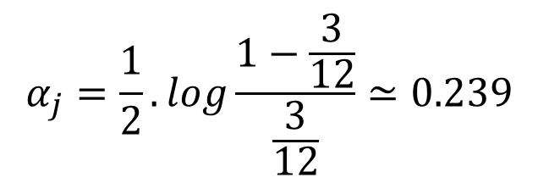
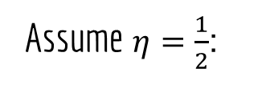
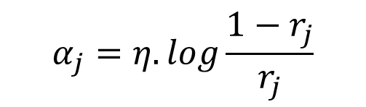
AdaBoost
Step 3
Size
Compute the Predictor weight (Amount of Say or Importance or Influence) of the $j^{th}$ predictor (Stump)
Learning Rate
S
M
L
$$α_{j}=η.log\frac{1−r_{j}}{r_{j}}$$
$$r_{j}=\frac{\frac{1}{12}+\frac{1}{12}+\frac{1}{12}}{1}=\frac{3}{12}$$
Assume $η=\frac{1}{2}$:
$$α_{j}=\frac{1}{2}.log\frac{1−\frac{3}{12}}{\frac{3}{12}}≃0.239$$

Slide 23
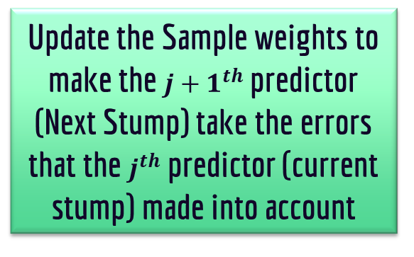
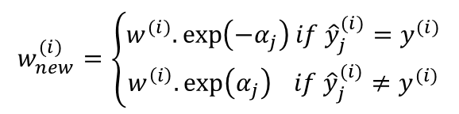
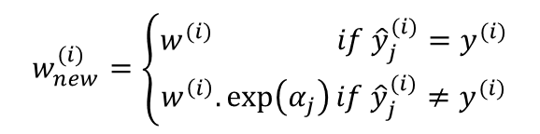
AdaBoost
Step 4
Animal | Color | Size | Cuteness |  | Record weight
Dog | Brown | Small | Medium |  | 1/12
Cat | Brown | Small | Medium |  | 1/12
Dog | Brown | Small | High |  | 1/12
Cat | Gold | Medium | High |  | 1/12
Cat | Black | Medium | High |  | 1/12
Dog | Gold | Small | Medium |  | 1/12
Cat | Brown | Medium | Low |  | 1/12
Dog | Gold | Large | High |  | 1/12
Cat | Brown | Medium | Medium |  | 1/12
Dog | Black | Large | High |  | 1/12
Cat | Gold | Large | Medium |  | 1/12
Cat | Brown | Small | High |  | 1/12
Update the Sample weights to make the ${j+1}^{th}$ predictor (Next Stump) take the errors that the $j^{th}$ predictor (current stump) made into account
$$w_{new}^{(i)}=\left\{\begin{aligned}w^{(i)} if {\hat{y}}_{j}^{(i)}=y^{(i)} \\ w^{\left(i\right)}.\exp\left(α_{j}\right)if {\hat{y}}_{j}^{(i)}≠y^{(i)}\end{aligned}\right.$$
OR
$$w_{new}^{(i)}=\left\{\begin{aligned}w^{(i)}.\exp\left({−α}_{j}\right)if {\hat{y}}_{j}^{(i)}=y^{(i)} \\ w^{\left(i\right)}.\exp\left(α_{j}\right) if {\hat{y}}_{j}^{(i)}≠y^{(i)}\end{aligned}\right.$$

Slide 24
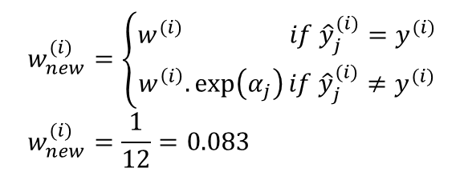
AdaBoost
Step 4
$$w_{new}^{(i)}=\left\{\begin{aligned}w^{(i)} if {\hat{y}}_{j}^{(i)}=y^{(i)} \\ w^{\left(i\right)}.\exp\left(α_{j}\right)if {\hat{y}}_{j}^{(i)}≠y^{(i)}\end{aligned}\right. \\ w_{new}^{(i)}=\frac{1}{12}=0.083$$
Animal | Color | Size | Cuteness |  | New Record weight
Dog | Brown | Small | Medium |  | 1/12
Cat | Brown | Small | Medium |  | 1/12
Dog | Brown | Small | High |  | 1/12
Cat | Gold | Medium | High |  | 1/12
Cat | Black | Medium | High |  | 1/12
Dog | Gold | Small | Medium |  | 1/12
Cat | Brown | Medium | Low |  | 1/12
Dog | Gold | Large | High |  | 1/12
Cat | Brown | Medium | Medium |  | 1/12
Dog | Black | Large | High |  | 1/12
Cat | Gold | Large | Medium |  | 1/12
Cat | Brown | Small | High |  | 1/12
Size
S
M
L

Slide 25
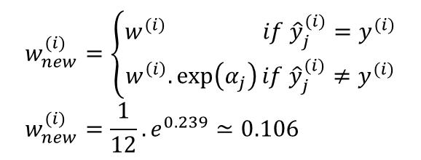
AdaBoost
Step 4
Animal | Color | Size | Cuteness |  | New Record weight
Dog | Brown | Small | Medium |  | 1/12
Cat | Brown | Small | Medium |  | 1/12
Dog | Brown | Small | High |  | 1/12
Cat | Gold | Medium | High |  | 1/12
Cat | Black | Medium | High |  | 1/12
Dog | Gold | Small | Medium |  | 1/12
Cat | Brown | Medium | Low |  | 1/12
Dog | Gold | Large | High |  | 1/12
Cat | Brown | Medium | Medium |  | 1/12
Dog | Black | Large | High |  | 1/12
Cat | Gold | Large | Medium |  | 1/12
Cat | Brown | Small | High |  | 1/12
$$w_{new}^{(i)}=\left\{\begin{aligned}w^{(i)} if {\hat{y}}_{j}^{(i)}=y^{(i)} \\ w^{\left(i\right)}.\exp\left(α_{j}\right)if {\hat{y}}_{j}^{(i)}≠y^{(i)}\end{aligned}\right. \\ w_{new}^{(i)}=\frac{1}{12}.e^{0.239}≃0.106$$
Size
S
M
L

Slide 26
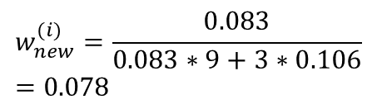
AdaBoost
Step 4
Normalize the new weights
Animal | Color | Size | Cuteness |  | New Normalized Record weight
Dog | Brown | Small | Medium |  | 0.083
Cat | Brown | Small | Medium |  | 0.106
Dog | Brown | Small | High |  | 0.083
Cat | Gold | Medium | High |  | 0.083
Cat | Black | Medium | High |  | 0.083
Dog | Gold | Small | Medium |  | 0.083
Cat | Brown | Medium | Low |  | 0.083
Dog | Gold | Large | High |  | 0.083
Cat | Brown | Medium | Medium |  | 0.083
Dog | Black | Large | High |  | 0.083
Cat | Gold | Large | Medium |  | 0.106
Cat | Brown | Small | High |  | 0.106
$$w_{new}^{(i)}=\frac{0.083}{0.083∗9+3∗0.106}=0.078$$

Slide 27
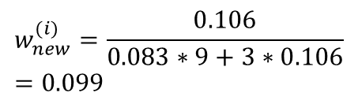
AdaBoost
Step 4
Normalize the new weights
Animal | Color | Size | Cuteness |  | New Normalized Record weight
Dog | Brown | Small | Medium |  | 0.078
Cat | Brown | Small | Medium |  | 0.106
Dog | Brown | Small | High |  | 0.083
Cat | Gold | Medium | High |  | 0.083
Cat | Black | Medium | High |  | 0.083
Dog | Gold | Small | Medium |  | 0.083
Cat | Brown | Medium | Low |  | 0.083
Dog | Gold | Large | High |  | 0.083
Cat | Brown | Medium | Medium |  | 0.083
Dog | Black | Large | High |  | 0.083
Cat | Gold | Large | Medium |  | 0.106
Cat | Brown | Small | High |  | 0.106
$$w_{new}^{(i)}=\frac{0.106}{0.083∗9+3∗0.106}=0.099$$

Slide 28
AdaBoost
Animal | Color | Size | Cuteness |  | New Normalized Record weight
Dog | Brown | Small | Medium |  | 0.078
Cat | Brown | Small | Medium |  | 0.099
Dog | Brown | Small | High |  | 0.078
Cat | Gold | Medium | High |  | 0.078
Cat | Black | Medium | High |  | 0.078
Dog | Gold | Small | Medium |  | 0.078
Cat | Brown | Medium | Low |  | 0.078
Dog | Gold | Large | High |  | 0.078
Cat | Brown | Medium | Medium |  | 0.078
Dog | Black | Large | High |  | 0.078
Cat | Gold | Large | Medium |  | 0.099
Cat | Brown | Small | High |  | 0.099
Step 4
Normalize the new weights

Slide 29
AdaBoost
Animal | Color | Size | Cuteness |  | Record weight
Dog | Brown | Small | Medium |  | 0.078
Cat | Brown | Small | Medium |  | 0.099
Dog | Brown | Small | High |  | 0.078
Cat | Gold | Medium | High |  | 0.078
Cat | Black | Medium | High |  | 0.078
Dog | Gold | Small | Medium |  | 0.078
Cat | Brown | Medium | Low |  | 0.078
Dog | Gold | Large | High |  | 0.078
Cat | Brown | Medium | Medium |  | 0.078
Dog | Black | Large | High |  | 0.078
Cat | Gold | Large | Medium |  | 0.099
Cat | Brown | Small | High |  | 0.099
Step 5
Reuse the data with the new Records (Samples) weights to build the next predictor (Stump) by repeating the steps from step 1

Slide 30
AdaBoost
Animal | Color | Size | Cuteness |  | Record weight | Accumulated weight
Dog | Brown | Small | Medium |  | 0.078 | 0.078
Cat | Brown | Small | Medium |  | 0.099 | 0.177
Dog | Brown | Small | High |  | 0.078 | 0.255
Cat | Gold | Medium | High |  | 0.078 | 0.333
Cat | Black | Medium | High |  | 0.078 | 0.411
Dog | Gold | Small | Medium |  | 0.078 | 0.489
Cat | Brown | Medium | Low |  | 0.078 | 0.567
Dog | Gold | Large | High |  | 0.078 | 0.645
Cat | Brown | Medium | Medium |  | 0.078 | 0.723
Dog | Black | Large | High |  | 0.078 | 0.802
Cat | Gold | Large | Medium |  | 0.099 | 0.9
Cat | Brown | Small | High |  | 0.099 | 1
Or Step 5
Sample the data using the weight distribution

Slide 31
AdaBoost
Animal | Color | Size | Cuteness |  | Record weight | Accumulated weight | Ranges
Dog | Brown | Small | Medium |  | 0.078 | 0.078 | [0,0.078]
Cat | Brown | Small | Medium |  | 0.099 | 0.177 | ] 0.078, 0.177]
Dog | Brown | Small | High |  | 0.078 | 0.255 | ] 0.177, 0.255]
Cat | Gold | Medium | High |  | 0.078 | 0.333 | ] 0.255, 0.333]
Cat | Black | Medium | High |  | 0.078 | 0.411 | ] 0.333, 0.411]
Dog | Gold | Small | Medium |  | 0.078 | 0.489 | ] 0.411, 0.489]
Cat | Brown | Medium | Low |  | 0.078 | 0.567 | ] 0.489, 0.567]
Dog | Gold | Large | High |  | 0.078 | 0.645 | ] 0.567, 0.645]
Cat | Brown | Medium | Medium |  | 0.078 | 0.723 | ] 0.645, 0.723]
Dog | Black | Large | High |  | 0.078 | 0.802 | ] 0.723, 0.802]
Cat | Gold | Large | Medium |  | 0.099 | 0.9 | ] 0.802, 0.9]
Cat | Brown | Small | High |  | 0.099 | 1 | ] 0.9, 1]
Or Step 5
Sample the data using the weight distribution

Slide 32
AdaBoost
Step 5
Sample the data using the weight distribution
Animal | Color | Size | Cuteness |  | Ranges
Dog | Brown | Small | Medium |  | [0,0.078]
Cat | Brown | Small | Medium |  | ] 0.078, 0.177]
Dog | Brown | Small | High |  | ] 0.177, 0.255]
Cat | Gold | Medium | High |  | ] 0.255, 0.333]
Cat | Black | Medium | High |  | ] 0.333, 0.411]
Dog | Gold | Small | Medium |  | ] 0.411, 0.489]
Cat | Brown | Medium | Low |  | ] 0.489, 0.567]
Dog | Gold | Large | High |  | ] 0.567, 0.645]
Cat | Brown | Medium | Medium |  | ] 0.645, 0.723]
Dog | Black | Large | High |  | ] 0.723, 0.802]
Cat | Gold | Large | Medium |  | ] 0.802, 0.9]
Cat | Brown | Small | High |  | ] 0.9, 1]
Animal | Color | Size | Cuteness
Cat | Brown | Small | High
0.95

Slide 33
AdaBoost
Step 5
Sample the data using the weight distribution
Animal | Color | Size | Cuteness |  | Ranges
Dog | Brown | Small | Medium |  | [0,0.078]
Cat | Brown | Small | Medium |  | ] 0.078, 0.177]
Dog | Brown | Small | High |  | ] 0.177, 0.255]
Cat | Gold | Medium | High |  | ] 0.255, 0.333]
Cat | Black | Medium | High |  | ] 0.333, 0.411]
Dog | Gold | Small | Medium |  | ] 0.411, 0.489]
Cat | Brown | Medium | Low |  | ] 0.489, 0.567]
Dog | Gold | Large | High |  | ] 0.567, 0.645]
Cat | Brown | Medium | Medium |  | ] 0.645, 0.723]
Dog | Black | Large | High |  | ] 0.723, 0.802]
Cat | Gold | Large | Medium |  | ] 0.802, 0.9]
Cat | Brown | Small | High |  | ] 0.9, 1]
Animal | Color | Size | Cuteness
Cat | Brown | Small | High
Cat | Brown | Small | Medium
0.15

Slide 34
AdaBoost
Step 5
Sample the data using the weight distribution
Animal | Color | Size | Cuteness |  | Ranges
Dog | Brown | Small | Medium |  | [0,0.078]
Cat | Brown | Small | Medium |  | ] 0.078, 0.177]
Dog | Brown | Small | High |  | ] 0.177, 0.255]
Cat | Gold | Medium | High |  | ] 0.255, 0.333]
Cat | Black | Medium | High |  | ] 0.333, 0.411]
Dog | Gold | Small | Medium |  | ] 0.411, 0.489]
Cat | Brown | Medium | Low |  | ] 0.489, 0.567]
Dog | Gold | Large | High |  | ] 0.567, 0.645]
Cat | Brown | Medium | Medium |  | ] 0.645, 0.723]
Dog | Black | Large | High |  | ] 0.723, 0.802]
Cat | Gold | Large | Medium |  | ] 0.802, 0.9]
Cat | Brown | Small | High |  | ] 0.9, 1]
Animal | Color | Size | Cuteness
Cat | Brown | Small | High
Cat | Brown | Small | Medium
Cat | Brown | Small | High
Cat | Brown | Small | Medium
Dog | Black | Large | High
Cat | Brown | Small | Medium
Dog | Gold | Small | Medium
Cat | Gold | Large | Medium
Cat | Brown | Small | Medium
Cat | Brown | Small | High
Cat | Gold | Large | Medium
Dog | Brown | Small | Medium

Slide 35
AdaBoost
Animal | Color | Size | Cuteness
Cat | Brown | Small | High
Cat | Brown | Small | Medium
Cat | Brown | Small | High
Cat | Brown | Small | Medium
Dog | Black | Large | High
Cat | Brown | Small | Medium
Dog | Gold | Small | Medium
Cat | Gold | Large | Medium
Cat | Brown | Small | Medium
Cat | Brown | Small | High
Cat | Gold | Large | Medium
Dog | Brown | Small | Medium
Step 5.5
Use this data to build the next predictor (Stump) by repeating the steps from step 0

Slide 36
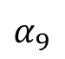
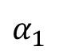
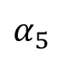
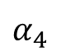
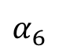
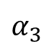
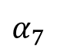
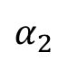
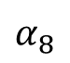
Make prediction using AdaBoost
$$α_{2}$$
$$α_{1}$$
$$α_{4}$$
$$α_{5}$$
$$α_{3}$$
$$α_{9}$$
$$α_{7}$$
$$α_{6}$$
$$α_{8}$$

Slide 37
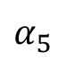
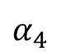
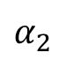
Make prediction using AdaBoost
$$α_{2}$$
$$α_{1}$$
$$α_{4}$$
$$α_{5}$$
$$α_{3}$$
$$α_{8}$$
$$α_{9}$$
$$α_{7}$$
$$α_{6}$$

Slide 38
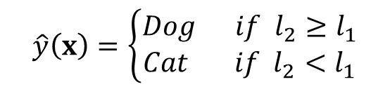
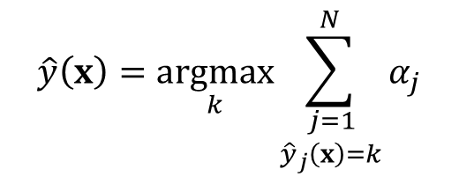
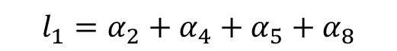
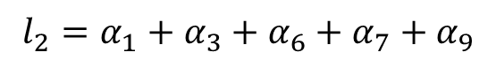
Make prediction using AdaBoost
$$\hat{y}\left(x\right)=\underset{k}{argmax}{\sum_{\begin{aligned}j=1 \\ {\hat{y}}_{j}\left(x\right)=k\end{aligned}}^{N}{α_{j}}}$$
$$l_{1}=α_{2}+α_{4}+α_{5}+α_{8}$$
$$l_{2}=α_{1}+α_{3}+α_{6}+α_{7}+α_{9}$$
$$\hat{y}\left(x\right)=\left\{\begin{aligned}Dog if l_{2}≥l_{1} \\ Cat if l_{2}<l_{1}\end{aligned}\right.$$

Slide 39
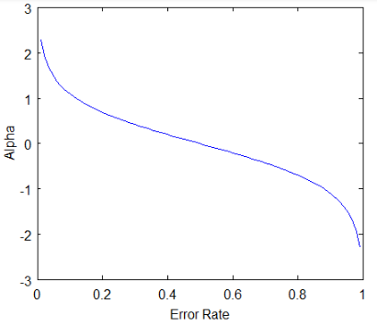
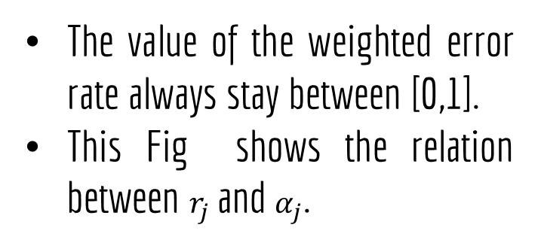
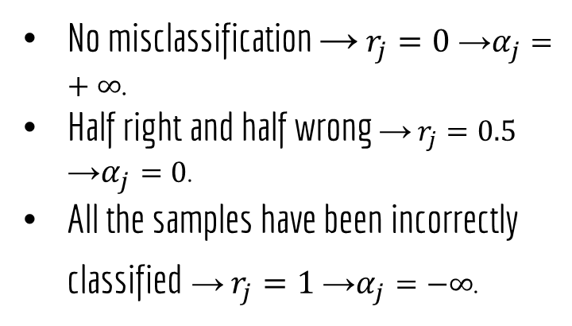
Notes
The value of the weighted error rate always stay between [0,1].
This Fig shows the relation between $r_{j}$ and $α_{j}$.
No misclassification → $r_{j}=0$ →$α_{j}=+∞$.
Half right and half wrong → $r_{j}=0.5$ →$α_{j}=0$.
All the samples have been incorrectly classified → $r_{j}=1$ →$α_{j}=−∞$.

Slide 40
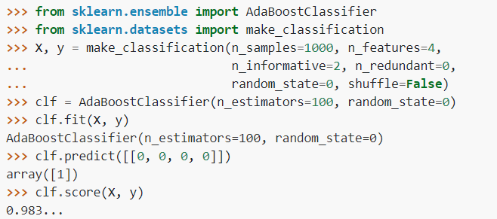
AdaBoost Classifier Using SkLearn
https://scikit-learn.org/stable/modules/generated/sklearn.ensemble.AdaBoostClassifier.html

Slide 41
Important parameters
estimator | The base classifier
n_estimators | The Number of base estimators in the ensemble.
learning_rate | Weight applied to each classifier at each boosting iteration
https://scikit-learn.org/stable/modules/generated/sklearn.ensemble.AdaBoostClassifier.html

Slide 42
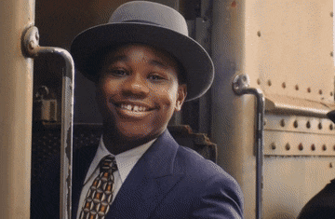
Thank you for listening

Slide 43
Any Questions
?

